Slide 1

Bootstrap v5
Build fast, responsive sites with Bootstrap
Prepared by Web Team

Slide 2
Contents
What is Bootstrap?
Why use Bootstrap
Getting Started
How to
Bootstrap Container
Bootstrap Grid System
Bootstrap Component

Slide 3
What is Bootstrap?

Slide 4
What is Bootstrap?
Introduction
Bootstrap is an open source toolkit for developing a sleek, intuitive, and powerful, mobile first front-end framework for faster and easier web development. It uses HTML, CSS and JavaScript.
A Brief History
Bootstrap was developed by Mark Otto and Jacob Thornton at Twitter. It was released as an open source product in August 2011 on GitHub.

Slide 5
What is Bootstrap?
A responsive grid system : Responsive Design
Easy to get started : knowledge of HTML, CSS and JavaScript with good documentation.
Reusable classes: UI elements such as pop-up and buttons to help style our content
Browser Support: Don’t need to worry about browser capability
Beautiful Interface: Allow user to create beautiful website
Many other things too: …

Slide 6
Getting Started

Slide 7
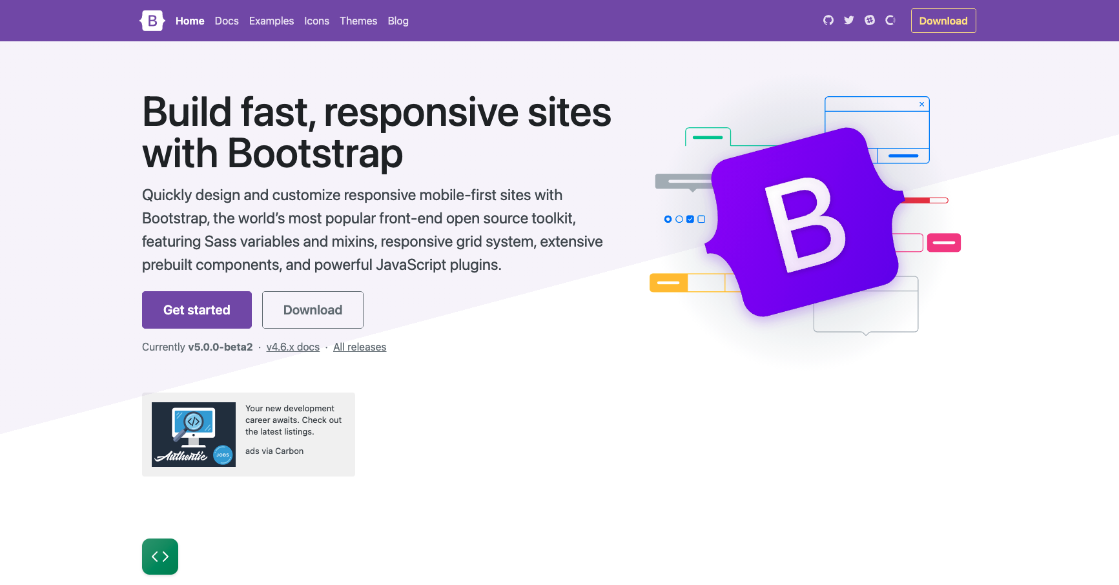
Getting Started
Go to Bootstrap Website: https://getbootstrap.com/

Slide 8
How to

Slide 9
How to
Bootstrap uses its own CSS and JS files, which you need to link to. You should also add the HTML5 <!DOCTYPE> as well as add two <meta> elements.
<!DOCTYPE html>
<html lang="en">
<head>
<meta name="viewport" content="width=device-width, initial-scale=1.0">
<meta http-equiv="X-UA-Compatible" content="ie=edge">
</head>
...
</html>

Slide 10
How to
There are two ways of linking these files:
Using Content Delivery Network (CDN)
Download ready-to-use compiled code

Slide 11
Setting up

Slide 12
Setting up
CSS:
Copy-paste the stylesheet <link> into your <head> before all other stylesheets to load our CSS.
<link href="https://cdn.jsdelivr.net/npm/bootstrap@5.0.0-beta2/dist/css/bootstrap.min.css"
rel="stylesheet" integrity="sha384-BmbxuPwQa2lc/FVzBcNJ7UAyJxM6wuqIj61tLrc4wSX0szH/Ev+nYRRuWlolflfl" crossorigin="anonymous">

Slide 13
Setting up
Bundle
Include every Bootstrap JavaScript plugin and dependency with one of our two bundles. Both bootstrap.bundle.js and bootstrap.bundle.min.js include Popper for our tooltips and popovers. For more information about what’s included in Bootstrap, please see our contents section.
<script src="https://cdn.jsdelivr.net/npm/bootstrap@5.0.0-beta2/dist/js/bootstrap.bundle.min.js" integrity="sha384-b5kHyXgcpbZJO/tY9Ul7kGkf1S0CWuKcCD38l8YkeH8z8QjE0GmW1gYU5S9FOnJ0" crossorigin="anonymous"></script>

Slide 14
Setting up
Separate
If you decide to go with the separate scripts solution, Popper must come first (if you’re using tooltips or popovers), and then our JavaScript plugins.
<script src="https://cdn.jsdelivr.net/npm/@popperjs/core@2.6.0/dist/umd/popper.min.js" integrity="sha384-KsvD1yqQ1/1+IA7gi3P0tyJcT3vR+NdBTt13hSJ2lnve8agRGXTTyNaBYmCR/Nwi" crossorigin="anonymous"></script>
<script src="https://cdn.jsdelivr.net/npm/bootstrap@5.0.0-beta2/dist/js/bootstrap.min.js" integrity="sha384-nsg8ua9HAw1y0W1btsyWgBklPnCUAFLuTMS2G72MMONqmOymq585AcH49TLBQObG" crossorigin="anonymous"></script>

Slide 15
Setting up
Starter template
Be sure to have your pages set up with the latest design and development standards. That means using an HTML5 doctype and including a viewport meta tag for proper responsive behaviors. Put it all together and your pages should look like this:
<!doctype html>
<html lang="en">
<head>
<!-- Required meta tags --> <meta charset="utf-8">
<meta name="viewport" content="width=device-width, initial-scale=1">
<!-- Bootstrap CSS -->
<link href="https://cdn.jsdelivr.net/npm/bootstrap@5.0.0- beta2/dist/css/bootstrap.min.css" rel="stylesheet" integrity="sha384- BmbxuPwQa2lc/FVzBcNJ7UAyJxM6wuqIj61tLrc4wSX0szH/Ev+nYRRuWlolflfl" crossorigin="anonymous">
<title>Hello, world!</title>
</head>

Slide 16
Setting up
Starter template
<body>
<h1>Hello, world!</h1>
<!-- Optional JavaScript; choose one of the two! --> <!-- Option 1: Bootstrap Bundle with Popper -->
<script src="https://cdn.jsdelivr.net/npm/bootstrap@5.0.0-beta2/dist/js/bootstrap.bundle.min.js" integrity="sha384-b5kHyXgcpbZJO/tY9Ul7kGkf1S0CWuKcCD38l8YkeH8z8QjE0GmW1gYU5S9FOnJ0" crossorigin="anonymous"></script>
<!-- Option 2: Separate Popper and Bootstrap JS -->
<!-- <script src="https://cdn.jsdelivr.net/npm/@popperjs/core@2.6.0/dist/umd/popper.min.js" integrity="sha384-KsvD1yqQ1/1+IA7gi3P0tyJcT3vR+NdBTt13hSJ2lnve8agRGXTTyNaBYmCR/Nwi" crossorigin="anonymous"></script>
<script src="https://cdn.jsdelivr.net/npm/bootstrap@5.0.0-beta2/dist/js/bootstrap.min.js" integrity="sha384-nsg8ua9HAw1y0W1btsyWgBklPnCUAFLuTMS2G72MMONqmOymq585AcH49TLBQObG" crossorigin="anonymous"></script> -->
</body>
</html>

Slide 17
Bootstrap Container

Slide 18
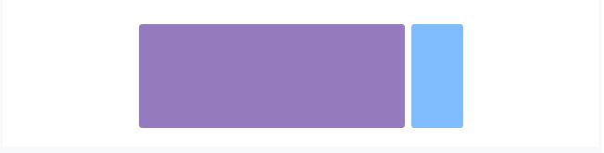
Bootstrap Containers
Container
<div class="container"> <!-- Content here --> </div>

Slide 19
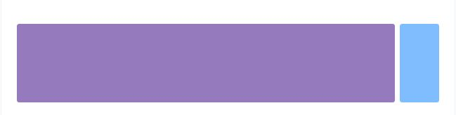
Bootstrap Containers
Container-fluid
Use .container-fluid for a full width container, spanning the entire width of the viewport.
<div class="container-fluid"> <!-- Content here --> </div>

Slide 20
Bootstrap Containers
Rows and Columns
Rows are wrappers for columns. Each column has horizontal padding (called a gutter) for controlling the space between them. This padding is then counteracted on the rows with negative margins. This way, all the content in your columns is visually aligned down the left side.
Column classes indicate the number of columns you’d like to use out of the possible 12 per row. So, if you want three equal-width columns across, you can use .col-4.

Slide 21
Bootstrap Grid System

Slide 22
Bootstrap Grid System
Responsive breakpoints
Since Bootstrap is developed to be mobile first, we use a handful of media queries to create sensible breakpoints for our layouts and interfaces. These breakpoints are mostly based on minimum viewport widths and allow us to scale up elements as the viewport changes.

Slide 23
Bootstrap Grid System
Responsive breakpoints
// Extra small devices (portrait phones, less than 576px) // No media query since this is the default in Bootstrap // Small devices (landscape phones, 576px and up) @media (min-width: 576px) { ... } // Medium devices (tablets, 768px and up) @media (min-width: 768px) { ... } // Large devices (desktops, 992px and up) @media (min-width: 992px) { ... } // Extra large devices (large desktops, 1200px and up) @media (min-width: 1200px) { ... }

Slide 24
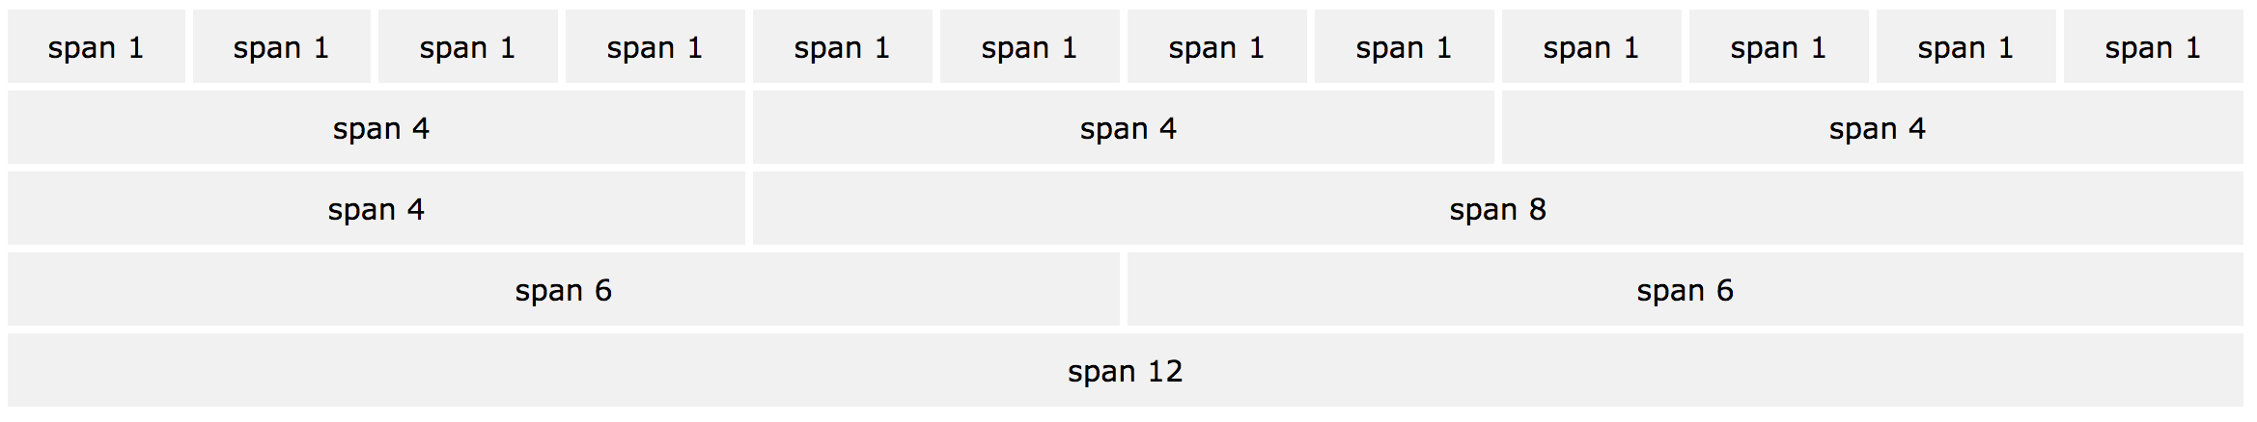
Bootstrap Grid System
Bootstrap 4 Grid System
Bootstrap's grid system is built with flexbox and allows up to 12 columns across the page.
If you do not want to use all 12 columns individually, you can group the columns together to create wider columns:

Slide 25
Bootstrap Grid System
Grid Classes
The Bootstrap 4 grid system has five classes:
.col- (extra small devices - screen width less than 576px)
.col-sm- (small devices - screen width equal to or greater than 576px)
.col-md- (medium devices - screen width equal to or greater than 768px)
.col-lg- (large devices - screen width equal to or greater than 992px)
.col-xl- (xlarge devices - screen width equal to or greater than 1200px)

Slide 26
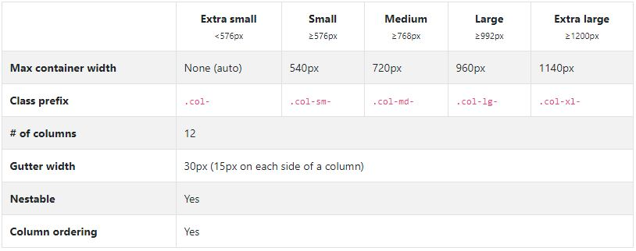
Bootstrap Grid System
Grid options
See how aspects of the Bootstrap grid system work across multiple devices with a handy table.

Slide 27
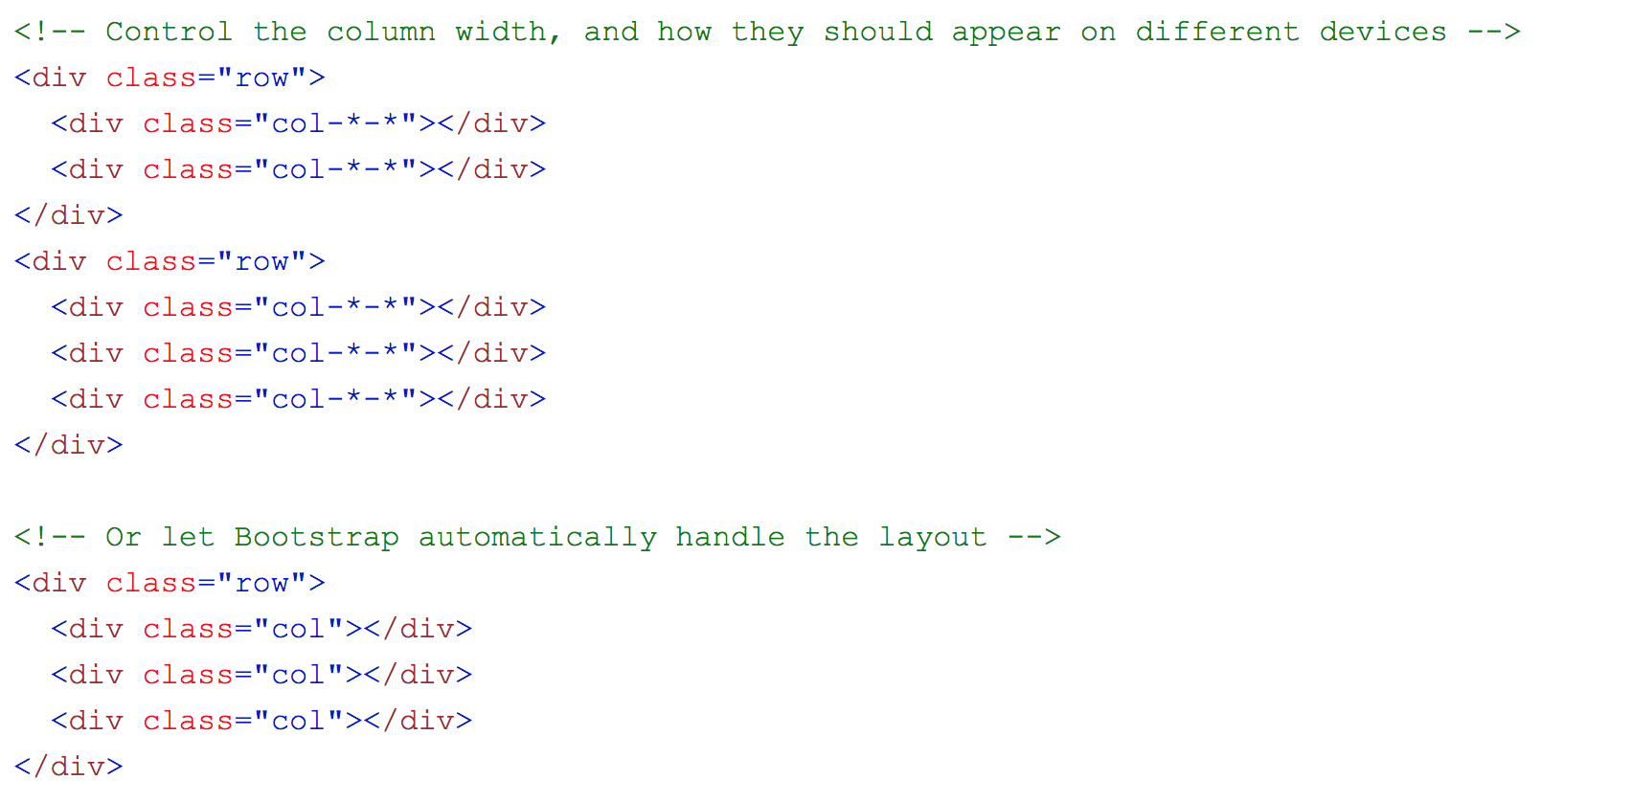
Bootstrap Grid System
Basic Structure of Bootstrap 5 Grid

Slide 28
Bootstrap Grid System
Things to Remember with Grids
Containers: Grids should be placed within a container (i.e. using either .container class or the .container-fluid class) for proper padding and alignment.
Rows & Columns
Rows contain one or more columns.
Columns contain the content. Only columns can be immediate children of rows.
Columns per Row
If more than 12 columns are placed in a row, the columns will wrap to a new line.
You don't have to use up all 12 columns. You can use any number of columns up to 12 (before it will wrap to the next line).
Equal-width multi-row
Create equal-width columns that span multiple rows by inserting a .w-100 where you want the columns to break to a new line.

Slide 29
Bootstrap Grid System
Colors
When getting to know bootstrap there are a few color code name that you should know. These colors are commonly used throughout various elements when using bootstrap. For example: .bg-primary to set background to primary color or .btn-danger to set button color to danger red.

Slide 30
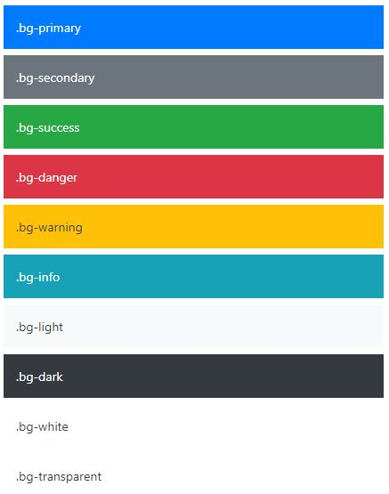
Bootstrap Grid System
Colors
Here are those color using with background

Slide 31
Bootstrap Component

Slide 32

Bootstrap Component
Buttons
Use Bootstrap’s custom button styles for actions in forms, dialogs, and more with support for multiple sizes, states, and more.
<button type="button" class="btn btn-primary">Primary</button>
<button type="button" class="btn btn-secondary">Secondary</button>
<button type="button" class="btn btn-success">Success</button>
<button type="button" class="btn btn-danger">Danger</button>
<button type="button" class="btn btn-warning">Warning</button>
<button type="button" class="btn btn-info">Info</button>
<button type="button" class="btn btn-light">Light</button>
<button type="button" class="btn btn-dark">Dark</button>
<button type="button" class="btn btn-link">Link</button>

Slide 33
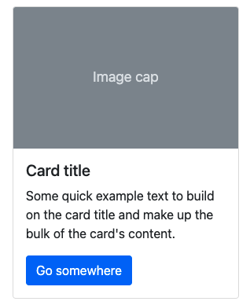
Bootstrap Component
Cards
Bootstrap’s cards provide a flexible and extensible content container with multiple variants and options.
<div class="card" style="width: 18rem;">
<img src="..." class="card-img-top" alt="...">
<div class="card-body">
<h5 class="card-title">Card title</h5>
<p class="card-text">Some quick example text to build on the card title and make up the bulk of the card's content.</p>
<a href="#" class="btn btn-primary">Go somewhere</a>
</div>
</div>

Slide 34
Bootstrap Grid System
Check other components in getBootstrap.com
Badge
Breadcrumb
Carousel
Modal
Navs & tabs
Navbar
Pagination
Toasts

Slide 35
Bootstrap Icons

Slide 36
Bootstrap Icons
Bootstrap Icons
Free, high quality, open source icon library with over 1,300 icons. Include them anyway you like—SVGs, SVG sprite, or web fonts. Use them with or without Bootstrap in any project.
Installation
npm
Download
CDN

Slide 37
Bootstrap Icons
CDN
Include the icon fonts stylesheet—in your website <head> or via @import in CSS—from our CDN and get started in seconds. See icon font docs for examples.
<link rel="stylesheet" href="https://cdn.jsdelivr.net/npm/bootstrap-icons@1.4.0/font/bootstrap-icons.css">
@import url("https://cdn.jsdelivr.net/npm/bootstrap-icons@1.4.0/font/bootstrap-icons.css");

Slide 38
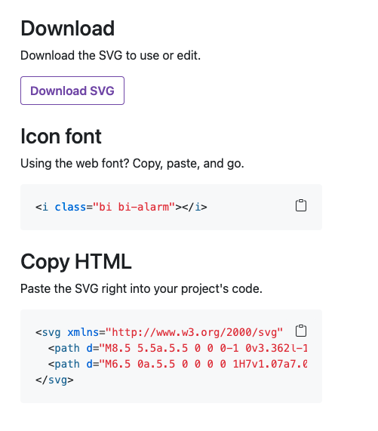
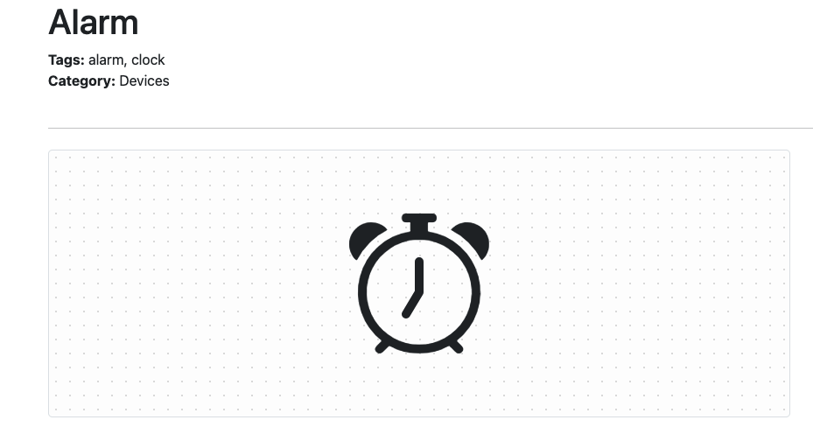
Bootstrap Icons
After using CDN or download :
We can copy the icon to use in our code.

Slide 39
Thank You

